Slide 1
Introduction to Algorithms
Levon Prazyan

Slide 2
Course Overview
Introduction
Sorting and Searching
Arrays and Lists
Stacks and Queues, Double Ended Queue
Heaps
Trees
Hash Tables
Dynamic Programming
Greedy Algorithms
Graph Algorithms
Network Flow
NP-Completeness

Slide 3
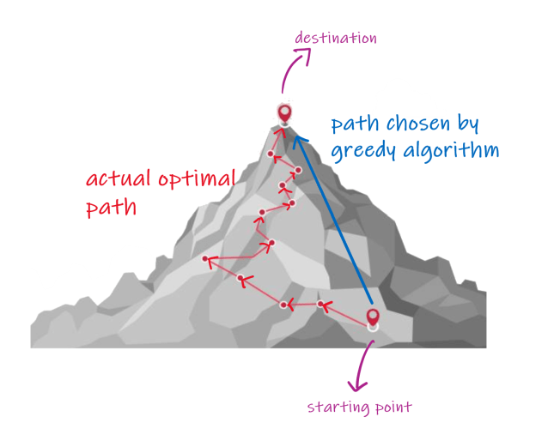
Greedy Algorithms
A greedy algorithm is a strategy for solving optimization problems by making the best possible (locally optimal) choice at each step, with the hope that these local choices lead to a globally optimal solution.
Greedy algorithms do not always yield optimal solutions, but for many problems they do.

Slide 4
Greedy Approach: Main Characteristics (1)
Local Optimal Choice: At each step, the algorithm chooses the option that seems best at that moment.
No backtracking
No reconsidering past decisions
Irrevocable Decisions: Once a choice is made, it is never changed. This makes greedy algorithms:
Fast
Simple to implement But sometimes risky if the problem doesn’t support greedy behavior

Slide 5
Greedy Approach: Main Characteristics (2)
Efficiency: Greedy algorithms are typically:
Time-efficient (often 𝑂(𝑛) or 𝑂(𝑛log⁡𝑛))
Use little memory
Not Always Optimal: Greedy works only for specific problems. For some problems, greedy choices can lead to suboptimal results.

Slide 6
Greddy Algorithms and DP
Aspect | Greedy | Dynamic Programming
Decision making | Local | Global
Revisits decisions | No | Yes
Complexity | Lower | Higher
Optimality | Not guaranteed | Guaranteed (if applicable)
If you’re unsure whether greedy works → it's often safer to think in terms of dynamic programming.

Slide 7
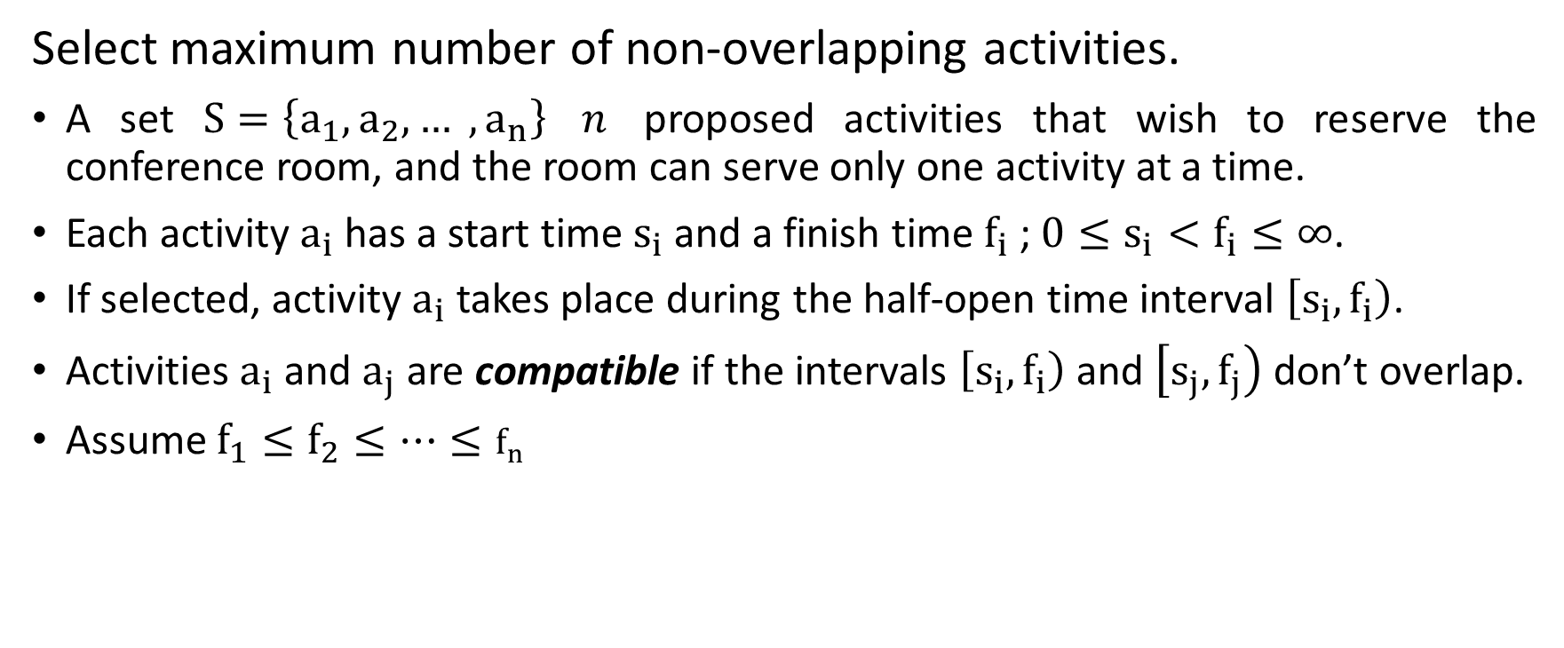
Activity Selection Problem (1)
Select maximum number of non-overlapping activities.
A set $S=\left\{a_{1},a_{2}, … ,a_{n}\right\}$ $n$ proposed activities that wish to reserve the conference room, and the room can serve only one activity at a time.
Each activity $a_{i}$ has a start time $s_{i}$ and a finish time $f_{i}$ ; $0≤s_{i}<f_{i}≤∞$.
If selected, activity $a_{i}$ takes place during the half-open time interval $\left[\left.s_{i},f_{i}\right)\right.$.
Activities $a_{i}$ and $a_{j}$ are compatible if the intervals $\left[\left.s_{i},f_{i}\right)\right.$ and $\left[\left.s_{j},f_{j}\right)\right.$ don’t overlap.
Assume $f_{1}≤f_{2}≤…≤f_{n}$
Notes:
Strategy: pick activity with earliest finishing time

Slide 8
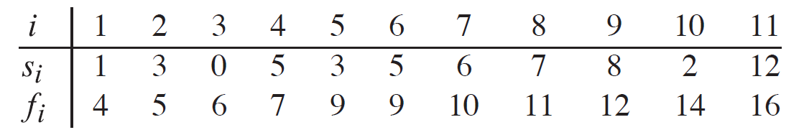
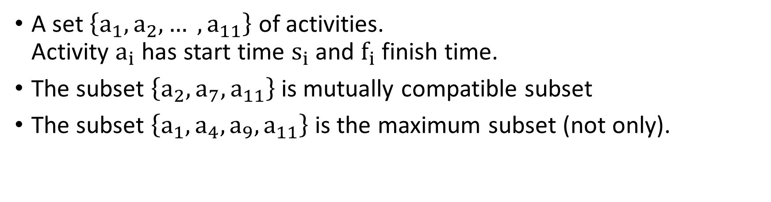
Activity Selection Problem (2)
A set $\left\{a_{1},a_{2}, … ,a_{11}\right\}$ of activities. Activity $a_{i}$ has start time $s_{i}$ and $f_{i}$ finish time.
The subset $\left\{a_{2},a_{7},a_{11}\right\}$ is mutually compatible subset
The subset $\left\{a_{1},a_{4},a_{9},a_{11}\right\}$ is the maximum subset (not only).

Slide 9
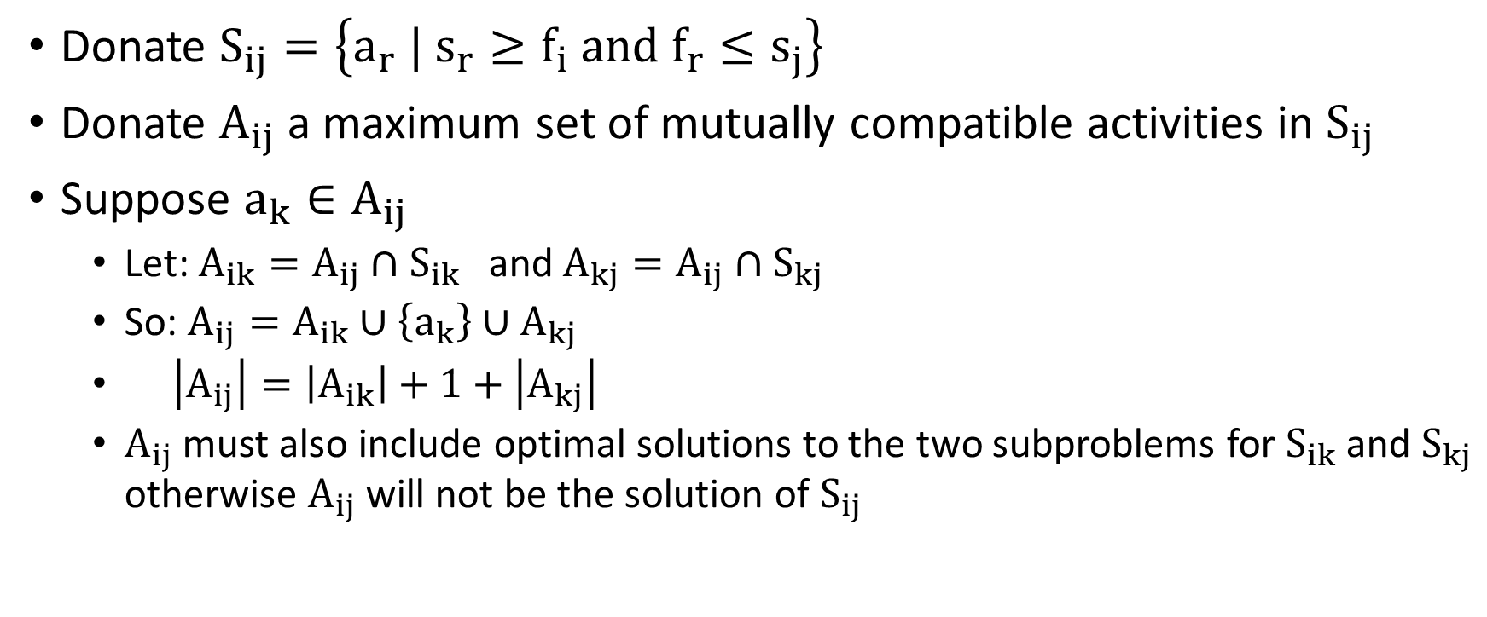
Activity Selection Problem: Optimal Substructure
Donate $S_{ij}=\left\{a_{r} | s_{r}≥f_{i} and f_{r}≤s_{j}\right\}$
Donate $A_{ij}$ a maximum set of mutually compatible activities in $S_{ij}$
Suppose $a_{k}∈A_{ij}$
Let: $A_{ik}=A_{ij}∩S_{ik}$ and $A_{kj}=A_{ij}∩S_{kj}$
So: $A_{ij}=A_{ik}∪\left\{a_{k}\right\}∪A_{kj}$
$\left|A_{ij}\right|=\left|A_{ik}\right|+1+\left|A_{kj}\right|$
$A_{ij}$ must also include optimal solutions to the two subproblems for $S_{ik}$ and $S_{kj}$ otherwise $A_{ij}$ will not be the solution of $S_{ij}$
Notes:
$S_{ij}$ - set of activities that start after activity $a_{i}$ finishes and that finish before activity $a_{j}$ starts.

Slide 10
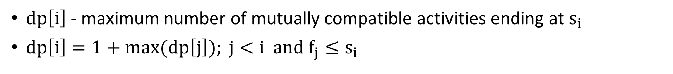
Activity Selection Problem: Dynamic Programming
$dp\left[i\right]$ - maximum number of mutually compatible activities ending at $s_{i}$
$dp\left[i\right]=1+max(dp\left[j\right]); j<i and f_{j}≤s_{i}$
i | Activity (s, f) | Compatible Prev j | dp[i] calculation | dp[i]
1 | (1, 4) | - | 1 | 1
2 | (3, 5) | - | 1 | 1
3 | (1, 6) | - | 1 | 1
4 | (5, 7) | 1, 2 | 1 + max(1, 1) | 2
5 | (5, 8) | 1, 2 | 1 + max(1, 1) | 2
6 | (3, 9) | - | 1 | 1
7 | (6, 10) | 1, 2, 3 | 1 + max(1, 1, 1) | 2
8 | (8, 11) | 1, 2, 3, 4, 5 | 1 + max(1, 1, 1, 2, 2) | 3

Slide 11
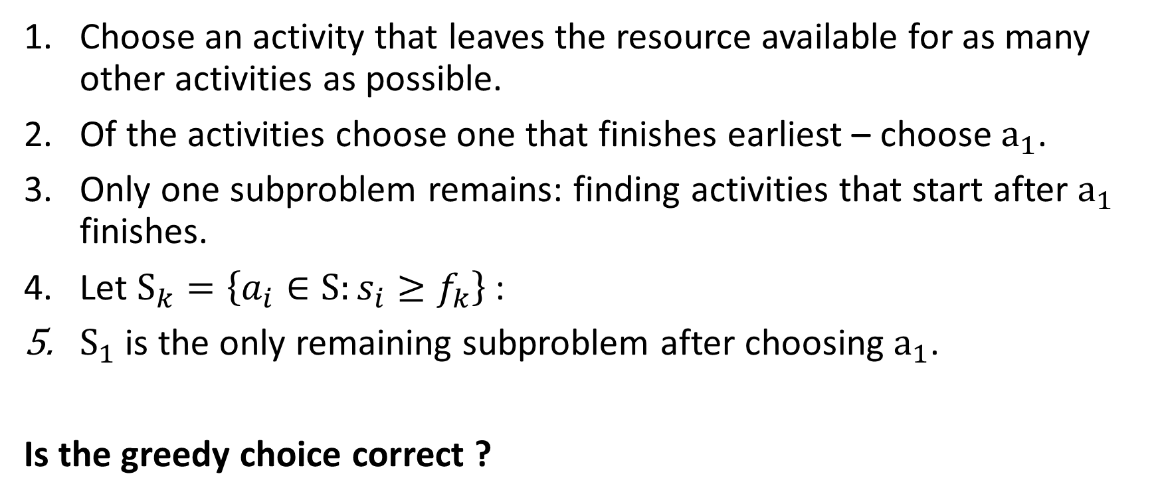
Activity Selection Problem: Greedy Choice (1)
Choose an activity that leaves the resource available for as many other activities as possible.
Of the activities choose one that finishes earliest – choose $a_{1}$.
Only one subproblem remains: finding activities that start after $a_{1}$ finishes.
Let $S_{k}=\left\{a_{i}∈S:s_{i}≥f_{k}\right\}$ :
$S_{1}$ is the only remaining subproblem after choosing $a_{1}$.
Is the greedy choice correct ?
Notes:
Choose $a1$

Slide 12
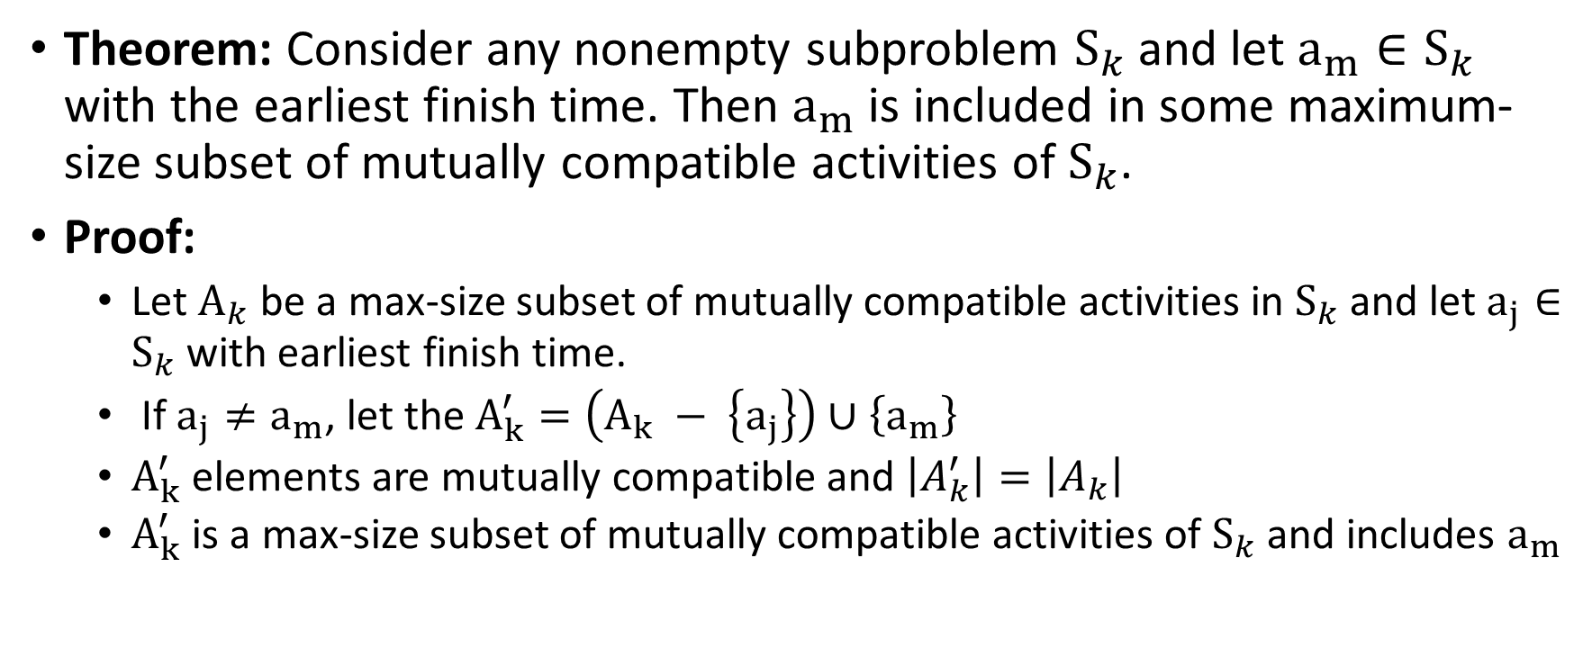
Activity Selection Problem: Greedy Choice (2)
Theorem: Consider any nonempty subproblem $S_{k}$ and let $a_{m}∈S_{k}$ with the earliest finish time. Then $a_{m}$ is included in some maximum-size subset of mutually compatible activities of $S_{k}$.
Proof:
Let $A_{k}$ be a max-size subset of mutually compatible activities in $S_{k}$ and let $a_{j}∈S_{k}$ with earliest finish time.
If $a_{j}≠a_{m}$, let the $A_{k}^{′}=\left(A_{k} − \left\{a_{j}\right\}\right)∪\left\{a_{m}\right\}$
$A_{k}^{′}$ elements are mutually compatible and $\left|A_{k}^{′}\right|=\left|A_{k}\right|$
$A_{k}^{′}$ is a max-size subset of mutually compatible activities of $S_{k}$ and includes $a_{m}$
Notes:
Choose $a1$

Slide 13
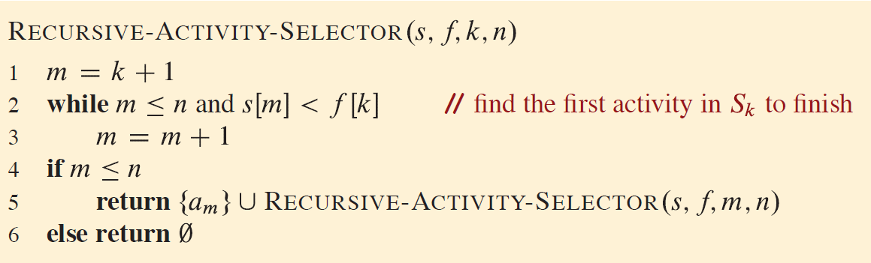
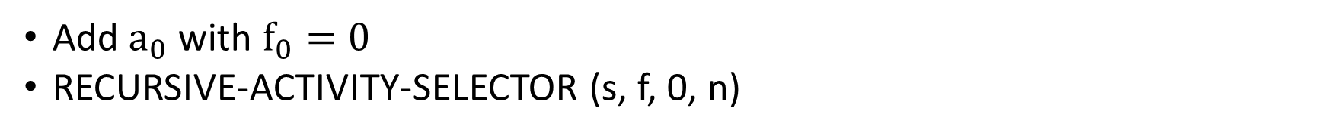
Activity Selection Problem: Recursive Greedy Algorithm
Add $a_{0}$ with $f_{0}=0$
RECURSIVE-ACTIVITY-SELECTOR (s, f, 0, n)
Notes:
Time: $θ\left(n\right)$

Slide 14
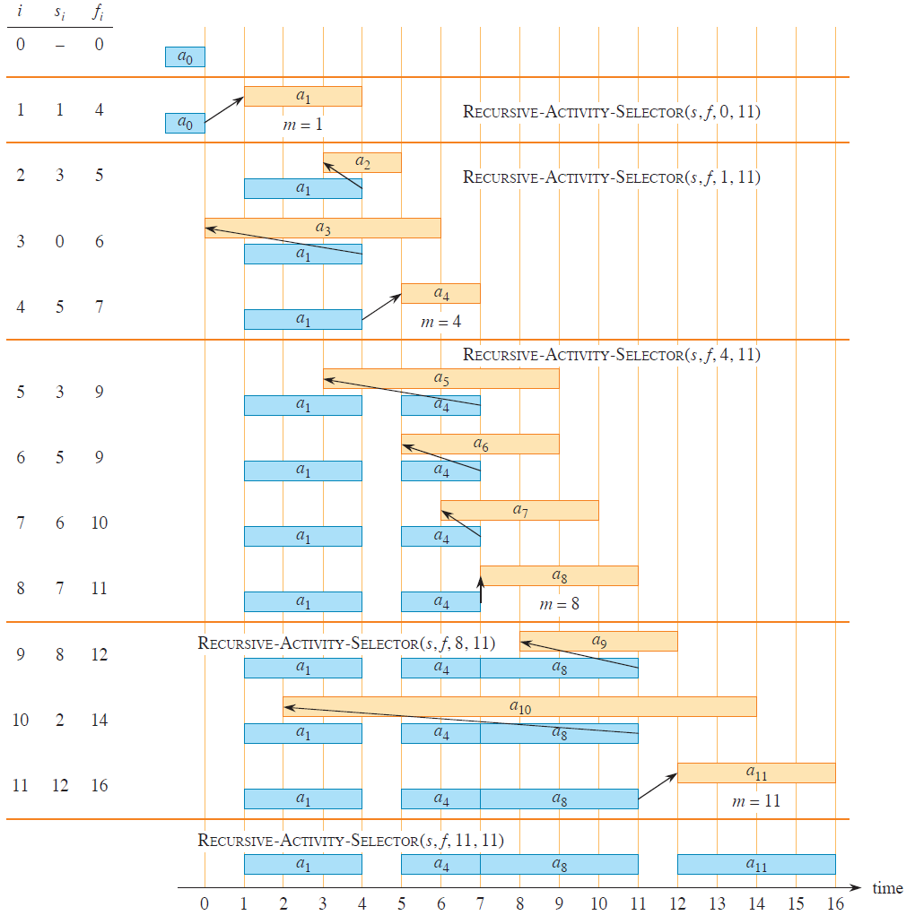
Activity Selection Problem: Recursive Greedy Algorithm Example
Notes:
Time: $θ\left(n\right)$

Slide 15
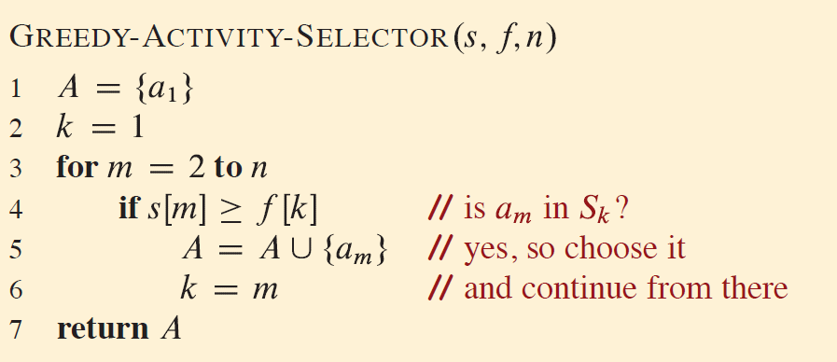
Activity Selection Problem: Iterative Greedy Algorithm
Notes:
Time: $θ\left(n\right)$

Slide 16
Elements of Greedy Strategy (1)
Determine the optimal substructure of the problem.
Develop a recursive solution.
Show that if you make the greedy choice, then only one subproblem remains.
Prove that it is always safe to make the greedy choice.
Develop a recursive algorithm that implements the greedy strategy.
Convert the recursive algorithm to an iterative algorithm.

Slide 17
Elements of Greedy Strategy (2)
Cast the optimization problem as one in which you make a choice and are left with one subproblem to solve.
Prove that there is always an optimal solution to the original problem that makes the greedy choice, so that the greedy choice is always safe.
Demonstrate optimal substructure by showing that, having made the greedy choice, what remains is a subproblem with the property that if you combine an optimal solution to the subproblem with the greedy choice you have made, you arrive at an optimal solution to the original problem.

Slide 18
Elements of Greedy Strategy (3)
How can you tell whether a greedy algorithm will solve a particular optimization problem?
No way works all the time, but
greedy-choise property and
optimal substructure
are two key ingredients.
Notes:
A problem has the greedy-choice property if a globally optimal solution can be obtained by making a locally optimal choice at each step, without reconsidering previous decisions.
A problem exhibits optimal substructure if an optimal
solution to the problem contains within it optimal solutions to subproblems.

Slide 19
Greedy Approach vs Dynamic Programming
Feature | Greedy Approach | Dynamic Programming
Optimality | May not always provide an optimal solution. | Guarantees an optimal solution if the problem exhibits the principle of optimality.
Subproblem Reuse | Does not reuse solutions to subproblems. | Reuses solutions to overlapping subproblems.
Backtracking | Does not involve backtracking. | Involves backtracking.
Complexity | Typically, simpler and faster to implement. | May be more complex and slower to implement.
Application | Suitable for problems where local optimization leads to global optimization. | Suitable for problems with overlapping subproblems and optimal substructure.
Notes:
Knapsack_01
Knapsack_fractional

Slide 20
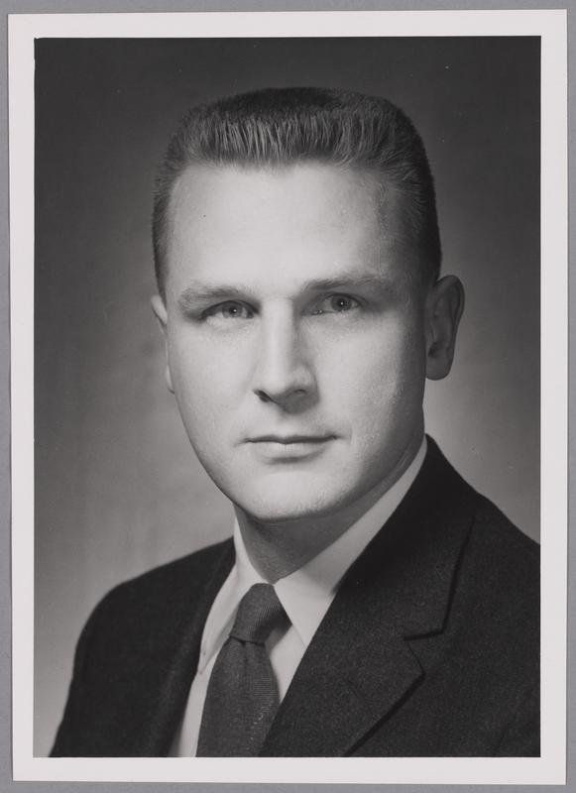
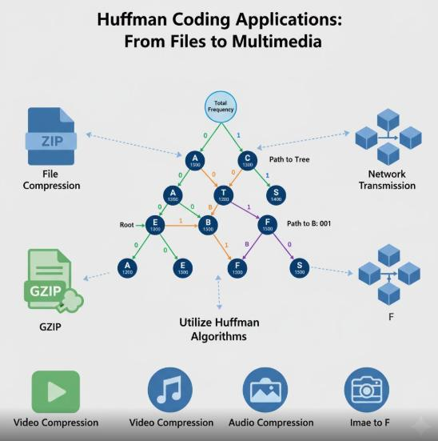
Huffman Coding
Notes:
savings of 20% to 90% are typical

Slide 21
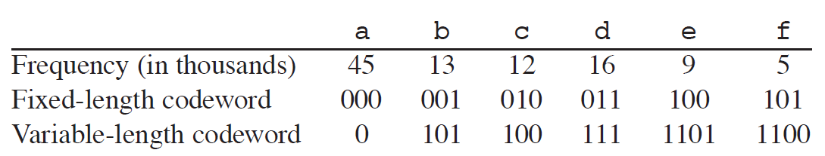
Huffman Coding (2)
The data arrive as a sequence of characters.
Huffman’s greedy algorithm uses a table giving how often each character occurs (its frequency) to build up an optimal way of representing each character as a binary string.
Suppose that you have a 100,000-character data file. Need to store them compactly. Only 6 characters in the file occur.
Notes:
savings of 20% to 90% are typical
Fixed-length - 300,000 bits
Var-length – 224,000 bits

Slide 22
Huffman Coding (3)
No codeword is also a prefix of some other codeword.
“face” = 1100∙0∙100∙1101 = 110001001101
“bed” = 101∙1101∙111 = 1011101111
“decaf” = 111∙1101∙100∙0∙1100 = 111110110001100
Notes:
savings of 20% to 90% are typical
Fixed-length - 300,000 bits
Var-length – 224,000 bits

Slide 23
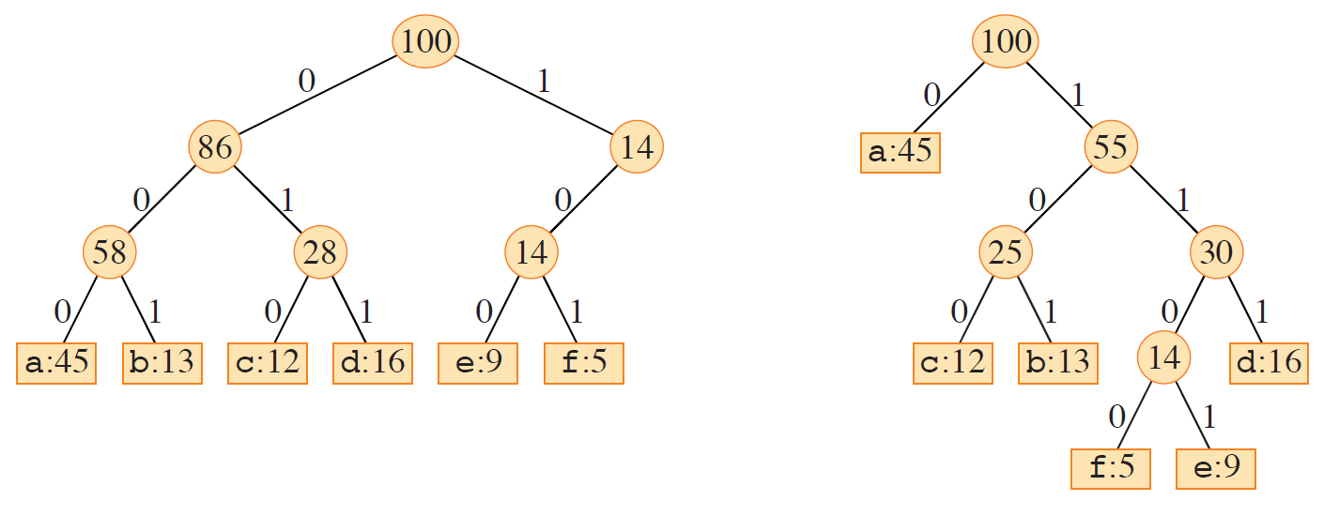
Huffman Coding: Decoding
Notes:
Each leaf is labeled with a character and its frequency of occurrence.
Each internal node is labeled with the sum of the frequencies of the leaves in its subtree.3
0 means “go to the left child” and 1 means “go to the right child”.

Slide 24
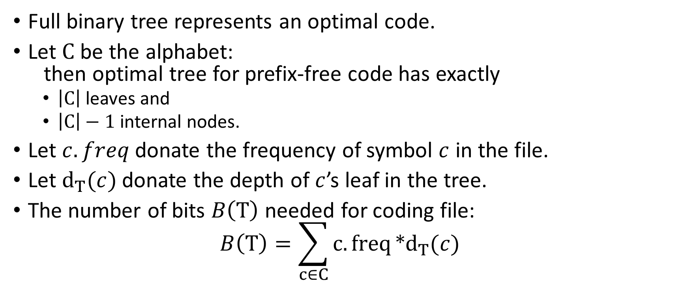
Huffman Coding: Cost
Full binary tree represents an optimal code.
Let $C$ be the alphabet: then optimal tree for prefix-free code has exactly
$\left|C\right|$ leaves and
$\left|C\right|−1$ internal nodes.
Let $c.freq$ donate the frequency of symbol $c$ in the file.
Let $d_{T}(c)$ donate the depth of $c$’s leaf in the tree.
The number of bits $B\left(T\right)$ needed for coding file: $B\left(T\right)=\sum_{c∈C}{c.freq}*d_{T}(c)$

Slide 25
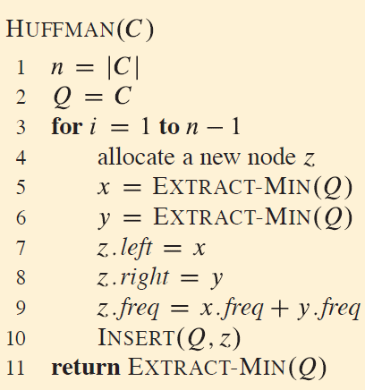

Huffman Coding: Algorithm
$\left|C\right|−1$ merging
$Q$ is a min heap
$O\left(n∗\log{n}\right)$

Slide 26
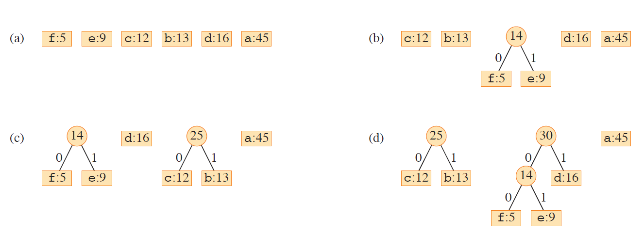
Huffman Coding: Building Tree (1)

Slide 27
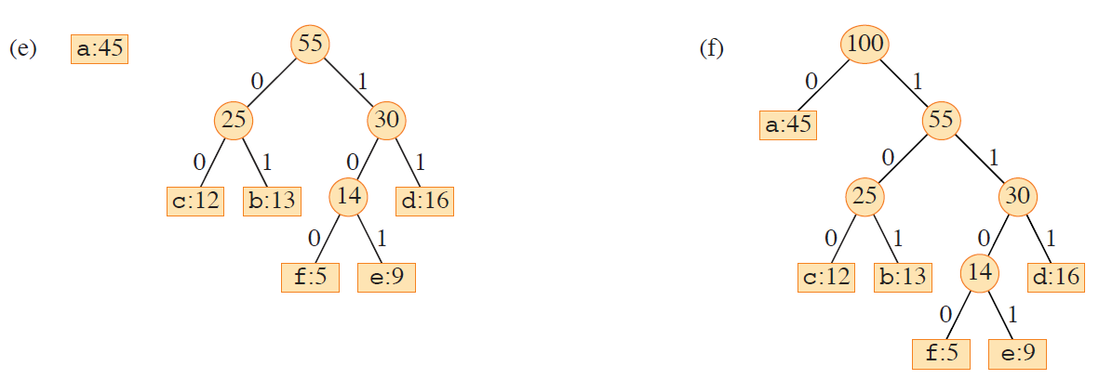
Huffman Coding: Building Tree (2)

Slide 28
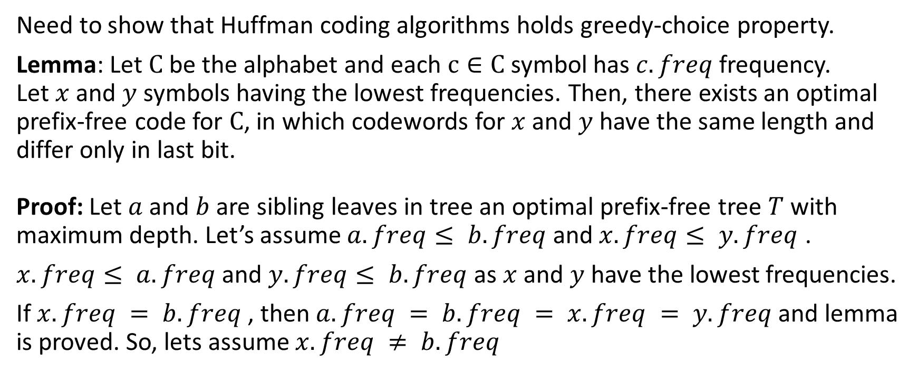
Huffman Coding: Correctness (1)
Need to show that Huffman coding algorithms holds greedy-choice property.
Lemma: Let $C$ be the alphabet and each $c∈C$ symbol has $c.freq$ frequency. Let $x$ and $y$ symbols having the lowest frequencies. Then, there exists an optimal prefix-free code for $C$, in which codewords for $x$ and $y$ have the same length and differ only in last bit. Proof: Let $a$ and $b$ are sibling leaves in tree an optimal prefix-free tree $T$ with maximum depth. Let’s assume $a.freq≤ b.freq$ and $x.freq≤ y.freq$ .
$x.freq≤ a.freq$and $y.freq≤ b.freq$ as $x$ and $y$ have the lowest frequencies.
If $x.freq = b.freq$, then $a.freq = b.freq = x.freq = y.freq$ and lemma is proved. So, lets assume $x.freq ≠ b.freq$

Slide 29
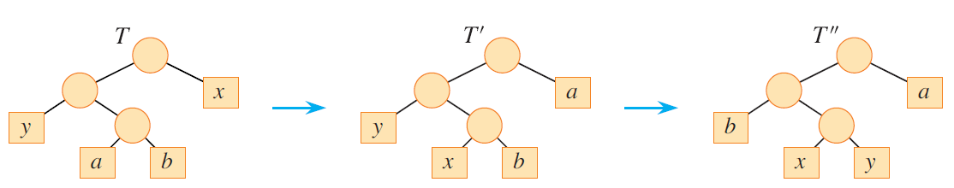
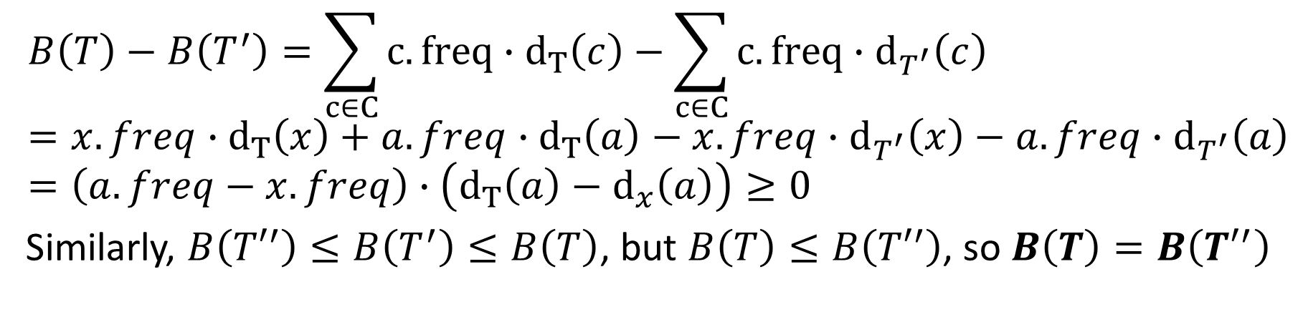
Huffman Coding: Correctness (2)
$$B\left(T\right)−B\left(T^{′}\right)=\sum_{c∈C}{c.freq}∙d_{T}\left(c\right)−\sum_{c∈C}{c.freq}∙d_{T^{′}}\left(c\right)=x.freq∙d_{T}\left(x\right)+a.freq∙d_{T}\left(a\right)−x.freq∙d_{T^{′}}\left(x\right)−a.freq∙d_{T^{′}}\left(a\right)=\left(a.freq−x.freq\right)∙\left(d_{T}\left(a\right)−d_{x}\left(a\right)\right)≥0$$
Similarly, $B\left({T′}^{′}\right)≤B\left(T^{′}\right)≤B\left(T\right)$, but $B\left(T\right)≤B\left({T′}^{′}\right)$, so $B\left(T\right)=B\left({T′}^{′}\right)$
Notes:
Lemma implies that the process of building up an optimal tree by mergers
can, without loss of generality, begin with the greedy choice of merging together
those two characters of lowest frequency.

Slide 30
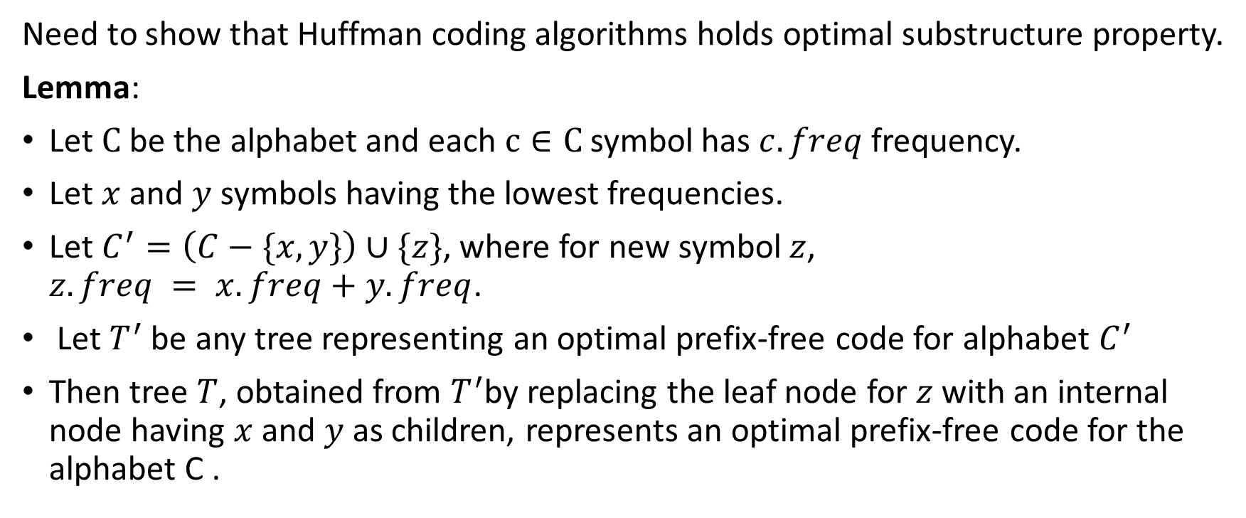
Huffman Coding: Correctness (3)
Need to show that Huffman coding algorithms holds optimal substructure property.
Lemma:
Let $C$ be the alphabet and each $c∈C$ symbol has $c.freq$ frequency.
Let $x$ and $y$ symbols having the lowest frequencies.
Let $C^{′}=\left(C−\{x, y\}\right)∪\{z\}$, where for new symbol $z$, $z.freq = x.freq+y.freq$.
Let $T^{′}$ be any tree representing an optimal prefix-free code for alphabet $C^{′}$
Then tree $T$, obtained from $T^{′}$by replacing the leaf node for $z$ with an internal node having $x$ and $y$ as children, represents an optimal prefix-free code for the alphabet C .

Slide 31
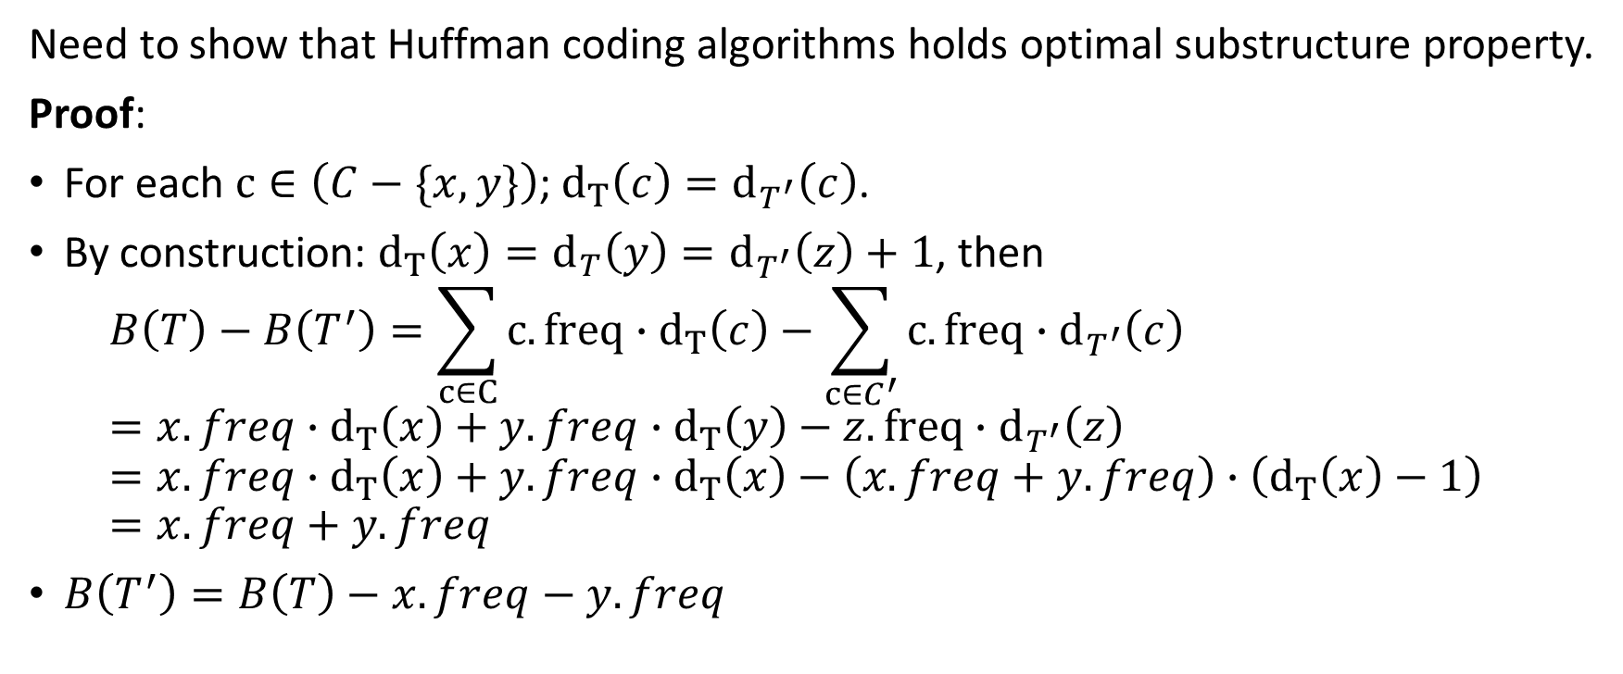
Huffman Coding: Correctness (3)
Need to show that Huffman coding algorithms holds optimal substructure property.
Proof:
For each $c∈\left(C−\{x, y\}\right)$; $d_{T}\left(c\right)=d_{T^{′}}\left(c\right)$.
By construction: $d_{T}\left(x\right)=d_{T}\left(y\right)=d_{T^{′}}\left(z\right)+1$, then $B\left(T\right)−B\left(T^{′}\right)=\sum_{c∈C}{c.freq∙d_{T}\left(c\right)}−\sum_{c∈C^{′}}{c.freq∙d_{T^{′}}\left(c\right)}=x.freq∙d_{T}\left(x\right)+y.freq∙d_{T}\left(y\right)−z.freq∙d_{T^{′}}\left(z\right)=x.freq∙d_{T}\left(x\right)+y.freq∙d_{T}\left(x\right)−\left(x.freq+y.freq\right)∙\left(d_{T}\left(x\right)−1\right)=x.freq+y.freq$
$B\left(T^{′}\right)=B\left(T\right)−x.freq−y.freq$

Slide 32
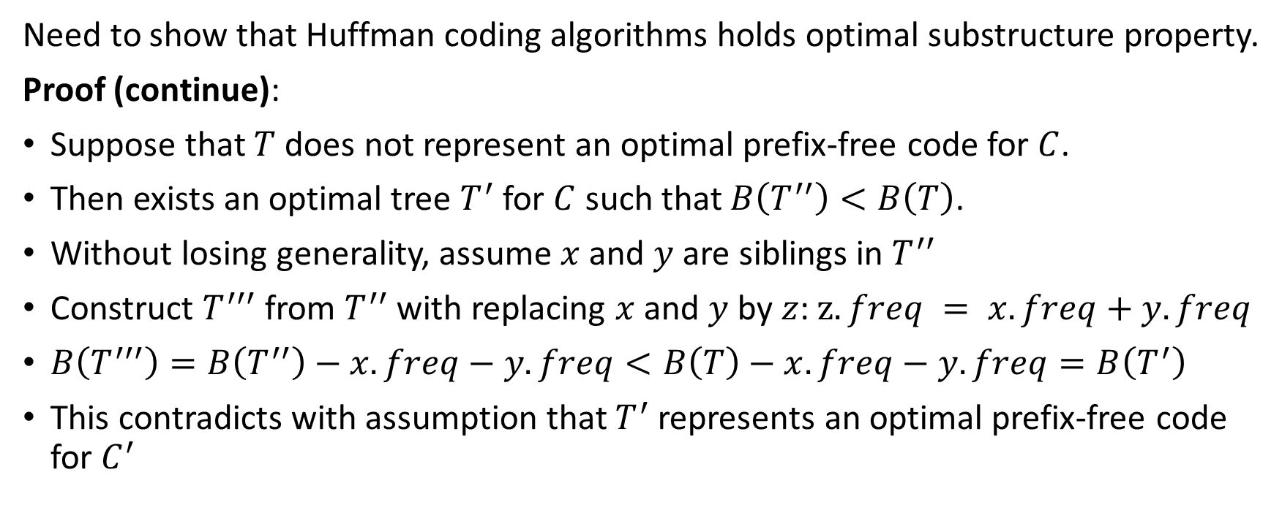
Huffman Coding: Correctness (4)
Need to show that Huffman coding algorithms holds optimal substructure property.
Proof (continue):
Suppose that $T$ does not represent an optimal prefix-free code for $C$.
Then exists an optimal tree $T^{′}$ for $C$ such that $B\left(T^{′′}\right)<B\left(T\right)$.
Without losing generality, assume $x$ and $y$ are siblings in $T^{′′}$
Construct $T^{′′′}$ from $T^{′′}$ with replacing $x$ and $y$ by $z$: $z.freq = x.freq+y.freq$
$B\left(T^{′′′}\right)=B\left(T^{′′}\right)−x.freq−y.freq<B\left(T\right)−x.freq−y.freq=B\left(T^{′}\right)$
This contradicts with assumption that $T^{′}$ represents an optimal prefix-free code for $C^{′}$

Slide 33
Thank You

